Slide 1
Learning Objective
I will be able to use derivatives to determine stationary points of a function
Success Criteria
At the end of the lesson, I will be able to:
Determine stationary points of a function

Slide 2
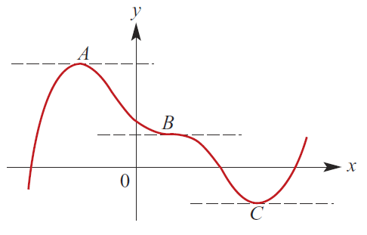
Stationary Point
Concept Development
If at point$x=a{, f}^{′}\left(a\right)=0$, $x=a$ is said to be a stationary point.
There are stationary points at A, B and C.
At such points, the gradient of the tangents are 0.

Slide 3
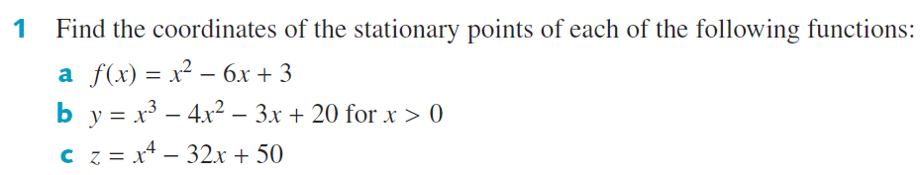
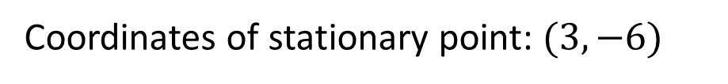





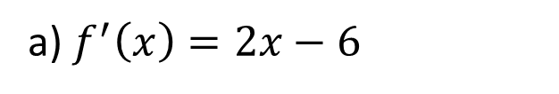








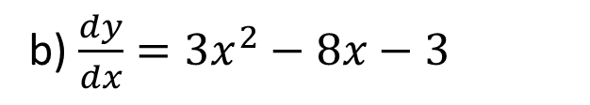
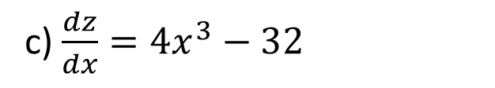
Guided Practice
c) $\frac{dz}{dx}=4x^{3}−32$
a) $f^{′}\left(x\right)=2x−6$
$$0=4x^{3}−32$$
$$2x−6=0$$
$$x=2$$
$$x=3$$
$$z=2$$
$$f\left(3\right)={\left(3\right)}^{2}−6\left(3\right)+3$$
Coordinates of stationary point: $(2, 2)$
$$f\left(3\right)=−6$$
Coordinates of stationary point: $(3, −6)$
b) $\frac{dy}{dx}=3x^{2}−8x−3$
$$3x^{2}−8x−3=0$$
$$\left(3x+1\right)\left(x−3\right)=0$$
$$y=2$$
Coordinates of stationary point: $(3, 2)$
$$x=3$$

Slide 4






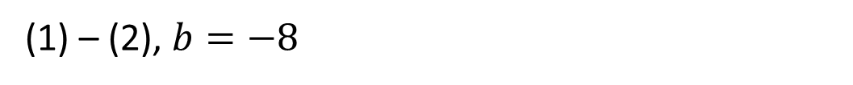

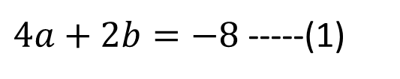


Guided Practice
Substitute (0, -1) into $y$,
$$c=−1$$
(1) – (2), $b=−8$
$$4a−8=0$$
Substitute (2, -9) into $y$,
$$a=2$$
$$−9=4a+2b−1$$
$4a+2b=−8$ -----(1)
$$\frac{dy}{dx}=2ax+b$$
$$2ax+b=0$$
Subst $x=2, 4a+b=0$----(2)

Slide 5




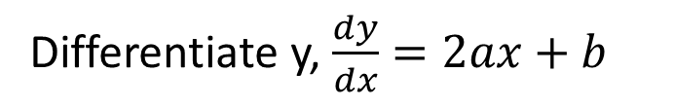





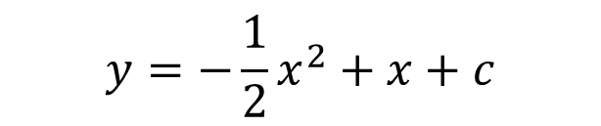
Guided Practice
$$y=−\frac{1}{2}x^{2}+x+c$$
Gradient of tangent at $x=0$
$$\tan\left(45\right)=1$$
Substitute (1, 2) into $y$,
Differentiate y, $\frac{dy}{dx}=2ax+b$
$$2=−\frac{1}{2}+1+c$$
Subst $x=0,\frac{dy}{dx}=1, b=1$
$$c=1\frac{1}{2}$$
$$\frac{dy}{dx}=2ax+1$$
Subst $x=1,\frac{dy}{dx}=0, 2a+1=0$
$$a=−\frac{1}{2}$$

Slide 6


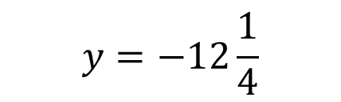





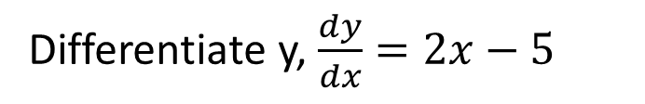




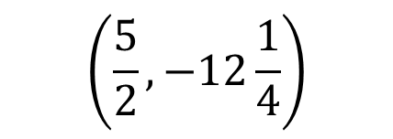
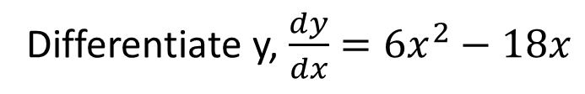



Guided Practice
Differentiate y, $\frac{dy}{dx}=2x−5$
Differentiate y, $\frac{dy}{dx}=6x^{2}−18x$
Solve for x by substituting $\frac{dy}{dx}=0,$
Solve for x by substituting $\frac{dy}{dx}=0,$
$$2x−5=0$$
$$6x\left(x−3\right)=0$$
$$x=\frac{5}{2}$$
$$x=0, x=3$$
Substitute $x=\frac{5}{2}$ into y
Substitute $x=0$ into y
$$y=27$$
Substitute $x=3$ into y
$$y=0$$
$$y=−12\frac{1}{4}$$
$$\left(\frac{5}{2}, −12\frac{1}{4}\right)$$
$$\left(0, 27\right) (3,0)$$

Slide 7




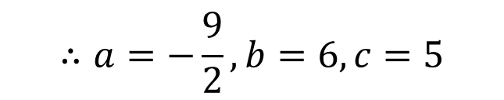









Guided Practice
Substitute $(0,5)$ into $y$
$$c=5$$
$$\left(1\right)−\left(2\right), b=6$$
Substitute $\left(2,7\right)$into y
Subst $b=6$ into (1)
$$7=8+4a+2b+5$$
$$4a+2b=−6 −−(1)$$
$$4a=−6−12$$
Differentiate y, $\frac{dy}{dx}=3x^{2}+2ax+b$
$$a=−\frac{9}{2}$$
Substitute $x=2,\frac{dy}{dx}=0$
$$∴a=−\frac{9}{2}, b=6,c=5$$
$$0=12+4a+b$$
$$4a+b=−12 −−(2)$$

Slide 8
Independent Practice
Complete Cambridge Ex 18C

